Slide 1

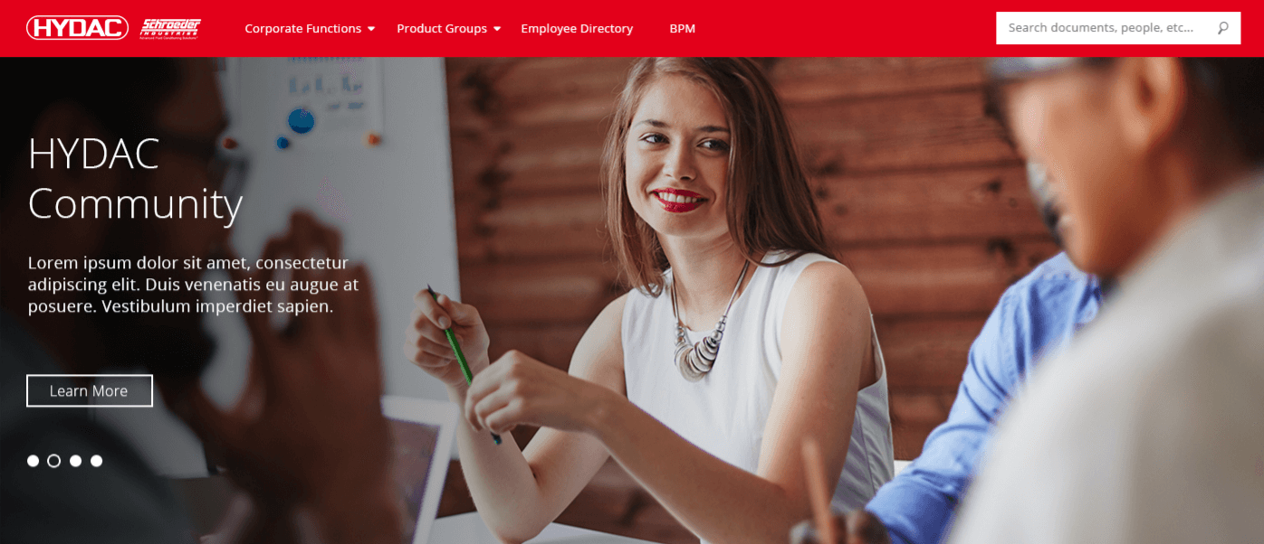
HYDAC Case Study
The Challenge
HYDAC, a manufacturer of hydraulic and engineering systems, needed to improve their existing intranet. Their intranet had several logistical complications and design issues. HYDAC wanted to institute a redesign that allowed for a more comfortable and intuitive navigation and user experience.
The existing intranet had several pain points. The process for creating new pages was time consuming and often required custom development. The design between different pages also lacked consistency in colors and layouts.
Affirma created a new site layout and architecture that centered around simple, intuitive navigation and design. A root site was created, that then branched into department sites and team sites. Each department site or team site would then branch into further department and team subsites. Different permission settings were created to allow for members to either read, contribute to, or operate the different portal sites. Only portal members could contribute to the site, and only portal owners had full permissions to make changes to sites. A consistent site theme was created, giving each site the same fonts, colors, and headers and footers. The unified theme gave HYDAC’s intranet a greater sense of teamwork and professionalism. Affirma implemented a global navigation header which allowed users greater control over the sites navigation. The intranet was also created to be fully responsive with mobile devices.
What We Did
Results
HYDAC completed their consultation satisfied with their newly designed intranet. The new intranet facilitates greater communication and unity among HYDAC team members, and allows for improved collaboration. Portal members can easily navigate the site architecture as well as post and share new material.

